Slide 1
Word List REVIEW: graph = writing

Slide 2
the written list of all the books used in a report or book

Slide 3
bibliography
the written list of all the books used in a report or book

Slide 4
a device that writes down (records) the movements of the earth

Slide 5
seismograph
a device that writes down (records) the movements of the earth

Slide 6
a word written the same way as another word but having a different meaning (e.g., bow--hair and bow—ship)

Slide 7
homograph
a word written the same way as another word but having a different meaning (e.g., bow--hair and bow—ship)

Slide 8
mapmaking; the writing involved in making maps or charts

Slide 9
cartography
mapmaking; the writing involved in making maps or charts

Slide 10
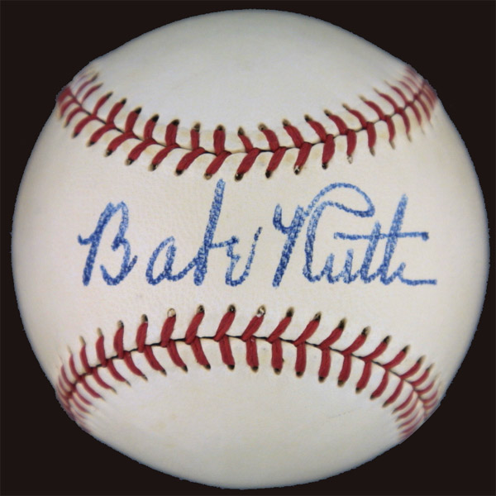
the writing of one’s name

Slide 11
autograph
the writing of one’s name

Slide 12
writing about a person’s life written by that person

Slide 13
autobiography
writing about a person’s life written by that person

Slide 14
a section of writing that has a topic and concluding sentence

Slide 15
paragraph
a section of writing that has a topic and concluding sentence

Slide 16
a book written about a person’s life

Slide 17
biography
a book written about a person’s life

Slide 18
record player; a device that turns the writing on records into sound

Slide 19
phonograph
record player; a device that turns the writing on records into sound

Slide 20
the use of light to record an image using a camera

Slide 21
photography
the use of light to record an image using a camera

